Slide 1

Network Data Transfer Protocols in IoT & Embedded

Slide 2
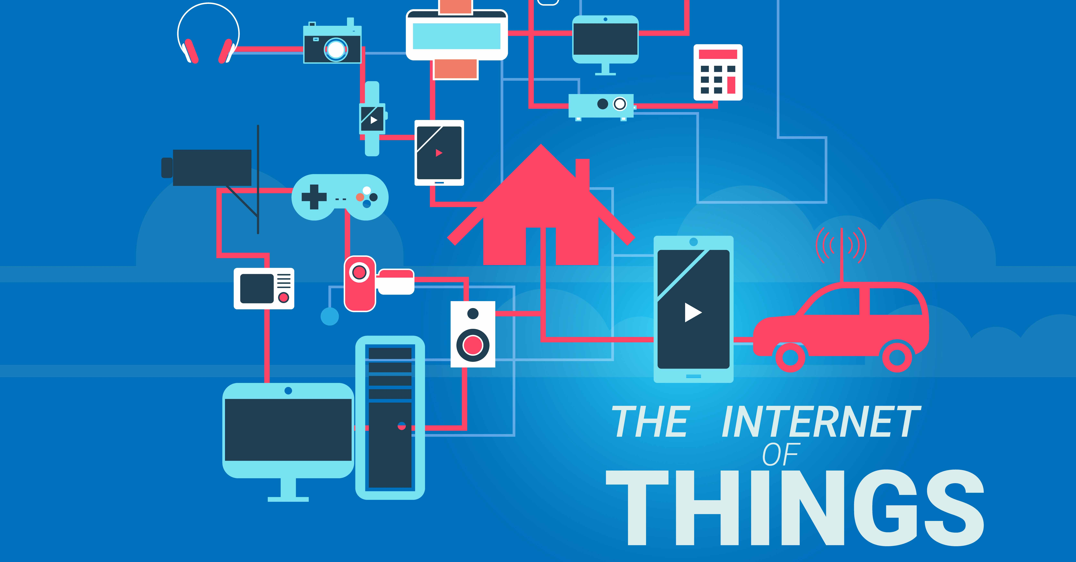
IOT = sensors + data + network + services
Simply put, the Internet of Things is a global network of computers, sensors and actuators that communicate with each other using the Internet Protocol IP (Internet Protocol).

Slide 3
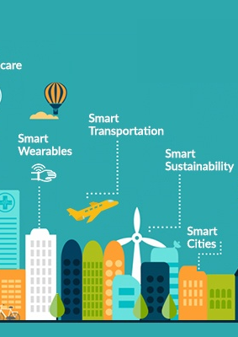
Practical Applications of IoT
“Smart Planet” - a person will be able to literally “keep abreast of the planet”: respond promptly to omissions in farm planning, pollution and other environmental problems, and therefore effectively manage non-renewable resources.
"Smart City" - urban infrastructure and related municipal services, such as education, health, public safety, housing and utilities, will become more connected and effective.
“Smart Home” - the system will recognize specific situations occurring in the house, and respond to them accordingly, which will provide residents with safety, comfort and resource saving.
“Smart Energy” - reliable and high-quality transmission of electrical energy from the source to the receiver will be provided at the right time and in the required amount.
“Smart transport” - moving passengers from one point of space to another will become easier, faster and safer.
“Smart medicine” - doctors and patients will be able to get remote access to expensive medical equipment or electronic medical records anywhere, a system of remote health monitoring will be implemented, the delivery of medicines to patients will be automated, and much more.

Slide 4
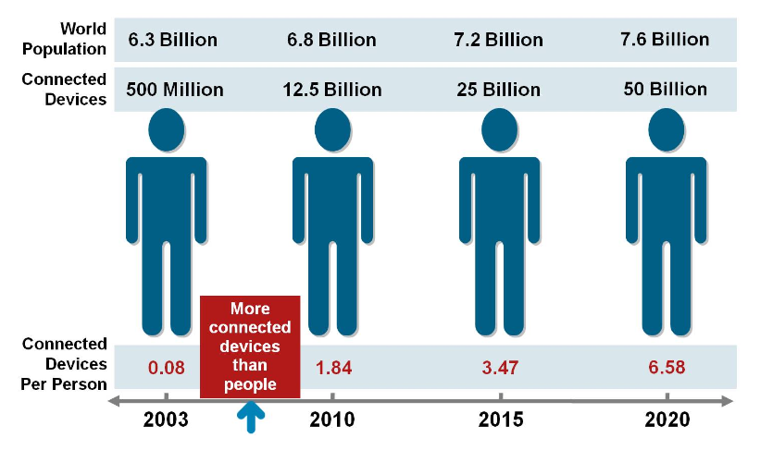
The time scale of the number of people and objects connected to the internet (Source: Cisco IBSG)

Slide 5
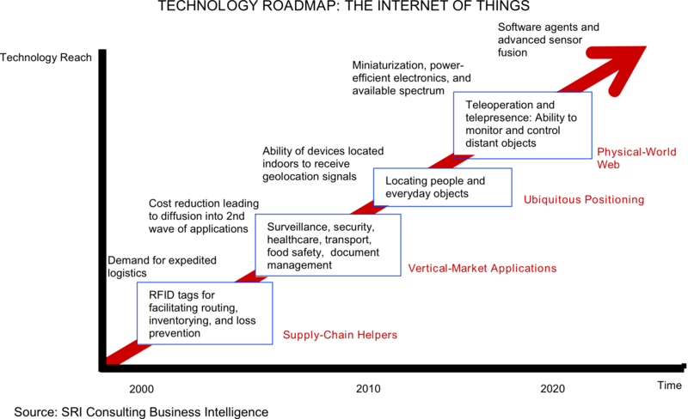
The process of developing the Internet of Things

Slide 6
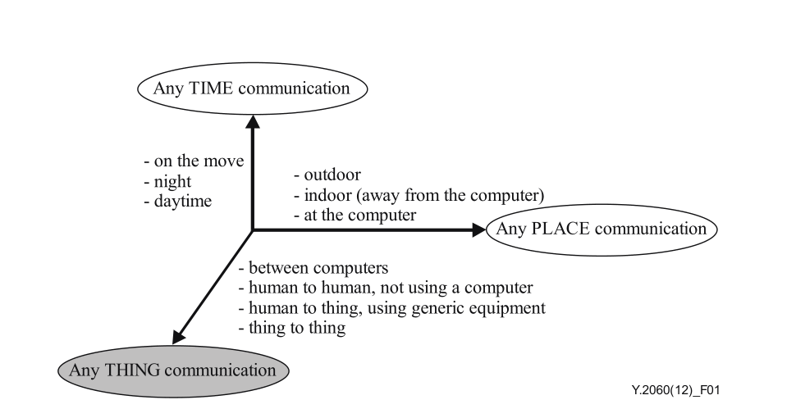
The new dimension introduced in the Internet of things [b-ITU Report]
The Internet of Things is based on three basic principles. Firstly, the ubiquitous communication infrastructure, secondly, the global identification of each object and, thirdly, the ability of each object to send and receive data through the personal network or the Internet to which it is connected.
- focus on things, not people; - significantly larger number of connected objects; - significantly smaller objects and low data transfer rates; - focus on reading information, not on communications; - the need to create new infrastructure and alternative standards.
Notes:
The Internet of Things is based on three basic principles. Firstly, the ubiquitous communication infrastructure, secondly, the global identification of each object and, thirdly, the ability of each object to send and receive data through the personal network or the Internet to which it is connected.
focus on things, not people; significantly larger number of connected objects; significantly smaller objects and low data transfer rates; focus on reading information, not on communications; the need to create new infrastructure and alternative standards.

Slide 7
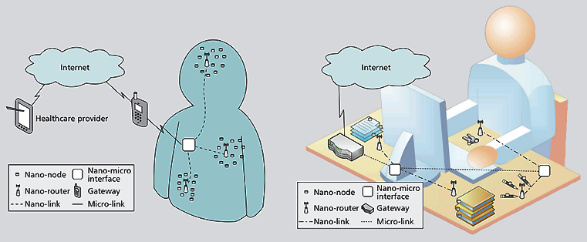
internet architecture nano-things
1. Nano-nodes are miniature and simplest nano-devices. Allow you to perform simple calculations, have limited memory and limited range of signal transmission. Examples of nano-nodes can be biological nano-sensors on the human body or inside it, or nano-devices embedded in everyday things around us - books, watches, keys, etc.
2. Nano-gateways - nano-devices have relatively high performance compared to nano-nodes and perform the function of collecting information from nano-nodes. In addition, nano-gateways can control the behavior of nano-nodes by performing simple commands (on / off, sleep mode, transmit data, etc.).
3. Nano-micro interfaces - devices that collect information from nano-gateways, and transmit it to external networks. These devices include both nano-technologies of communications and traditional technologies for transferring information to existing networks.
4. Gateway - this device monitors the entire nano-network through the Internet. For example, in the case of a network with sensors on the human body, this function can be performed by a mobile phone that transmits information about the required indicators to a medical institution.
https://www.researchgate.net/publication/313523261_Internet_of_Nano_Things_IoNT_Next_Evolutionary_Step_in_Nanotechnology/download

Slide 8
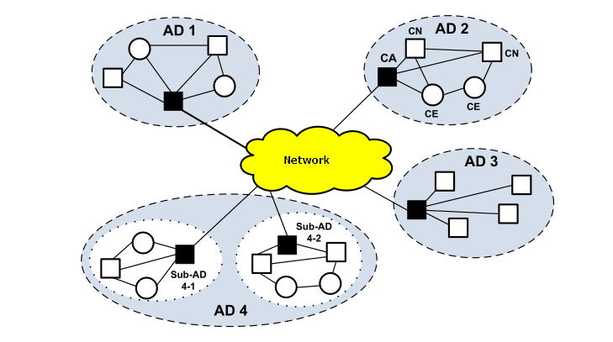
Cognitive Internet of Things
Cognitiveness means that the IoT object has the following general properties:
the ability to self-analyze and reconfigure taking into account the existing environment, as well as having in mind the achievement of goals determined by the tasks performed;
the ability to adapt one's condition according to the existing conditions or events, based on certain criteria and knowledge of previous states;
the ability to dynamically change its topology and / or operational parameters in accordance with the requirements of a particular user, when it is necessary within the framework of the current service policy, optimization of network bandwidth or other indicators;
self-configuration with rule-based distributed control;
the possibility of self-determination of their current state and, given this state, the planning of their work, making certain decisions in response to the current situation.
It seems that in practice, cognitive Internet things will be able to:
use technologies to gain knowledge about their operating and geographical environment, location, using standard positioning technologies;
set independently or use ready-made rules of interaction between objects;
dynamically and autonomously adjust their operational parameters and protocols in accordance with the knowledge gained in order to achieve predetermined
goals, in particular to choose the most appropriate technology of radio transmission;
be trained on the basis of the achieved results using the best practices and the most effective policies to achieve the goals of creating IoT.
https://www.researchgate.net/publication/329070183_Cognitive_Internet_of_Things

Slide 9
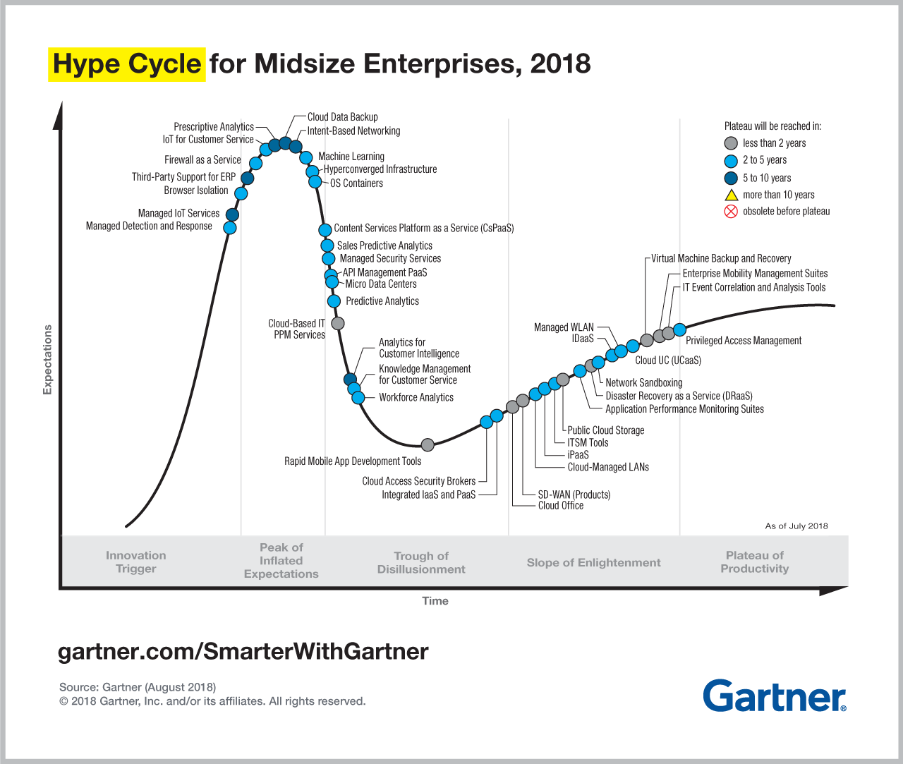
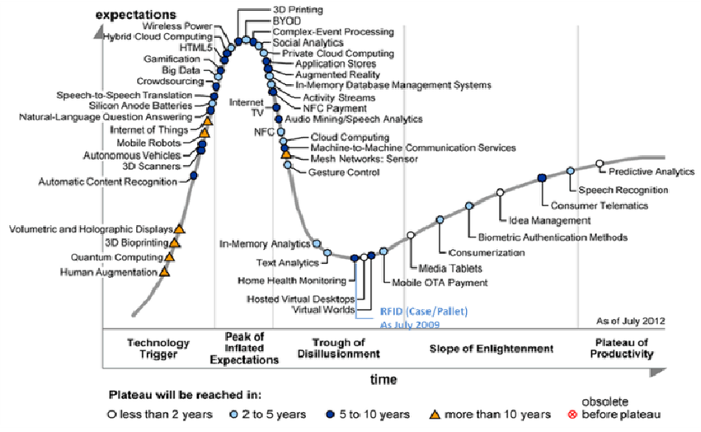
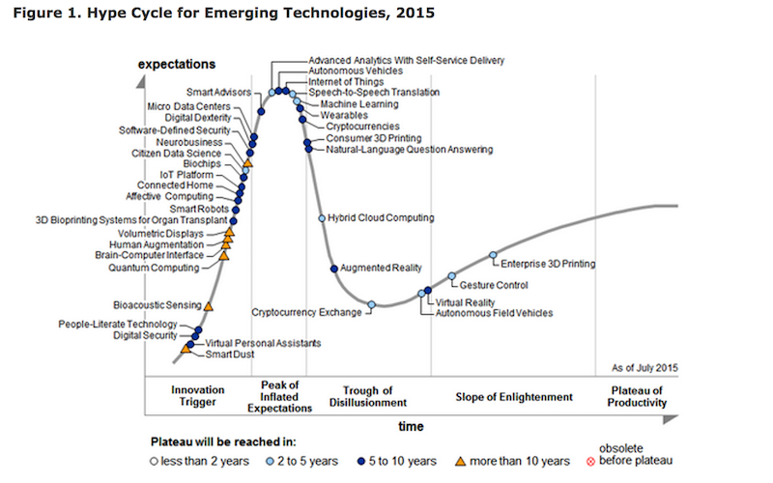
Maturity of the IoT concept and its component technologies
Since 2011, Gartner has placed the Internet of Things in the overall maturity cycle of new technologies at the initial stage of the “technological trigger” indicating the formation period of more than 10 years, and in 2012 a special maturity cycle was released for the technologies that form the basis of IoT

Slide 10
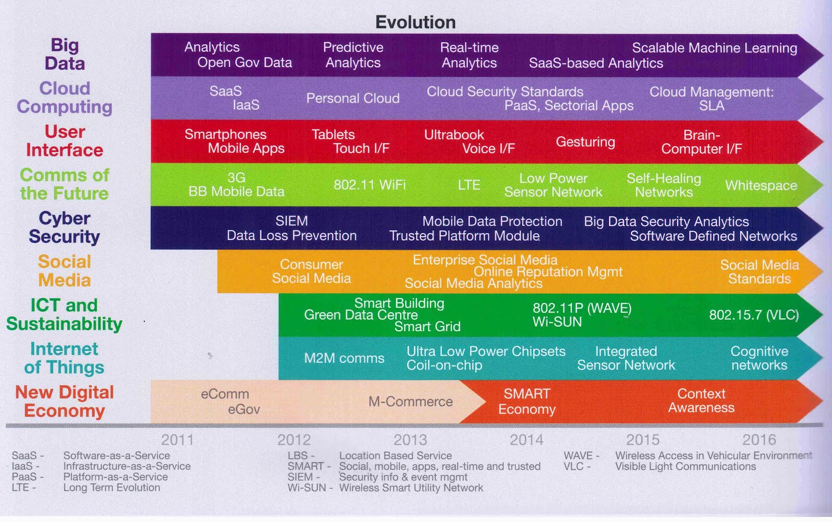
Evolution of the Internet of Things and related information and communication technologies
https://coolerinsights.com/2012/08/mapping-singapores-infocomm-future/

Slide 11
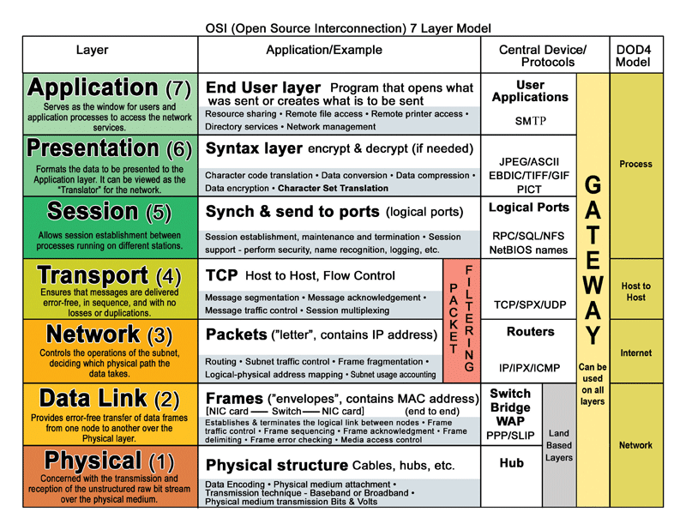
Open source interconnection layer model

Slide 12
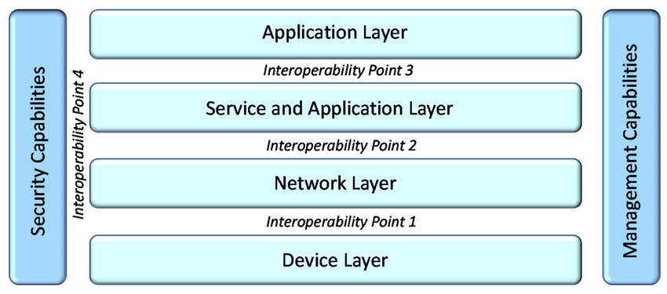
International Telecommunication Union, ITU-t
ITU-T SG20: IoT and its applications including smart cities and communities (SC&C)
Next Generation Networks Global Standards Initiative (NGN-GSI)
ITU-T IPTV Global Standards Initiative
https://www.itu.int/en/ITU-T/studygroups/2017-2020/20/Pages/default.aspx

Slide 13
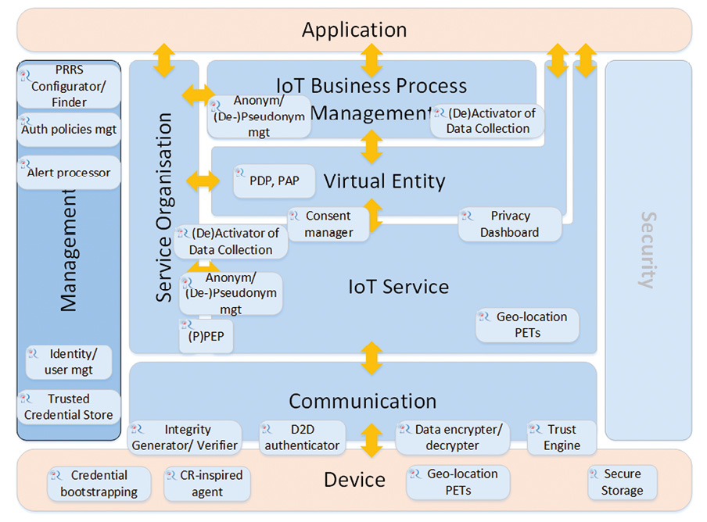
IoT-A Internet of Things – Architecture
The main goal of the European integration project IoT-A (Internet of Things - Architecture), which involves various companies, is to develop a reference architectural model of the Internet of things with a description of the main components that would allow integrating heterogeneous IoT technologies into a single interconnected architecture.
http://cocoa.ethz.ch/downloads/2014/01/1360_D1%202_Initial_architectural_reference_model_for_IoT.pdf

Slide 14
Types of Wireless Networks
Type of Network | Coverage Area | Function | Cost | Data Rate | Standards
WLAN | In buildings or campuses; typically 100 meters | Mobile extension of wired networks | Low-Medi um | 1-100 Mbps | 802.11a, b,g,n, Wi-Fi and HiperLAN/2
WPAN | within reach of a person, typically 10meters | Cable Replacement Technology, personal networks | Very Low | 0.1-4 Mbps | IrDA, Bluetooth, 802.15
WMAN | Within a city | Fixed Wireless between homes and businesses and the Internet | Medium- High | 134 Mbps | IEEE 802.16 and WIMAX
WWAN | Coverage provided on national basis from multiple carriers, | Mobile access to the Internet from outdoor areas | Medium- High | 8 Kbps-2 Mbps | GSM,TDMA, CDMA,GPRS,EDG E,WCDMA

Slide 15
Popular Protocols of WPAN
ZigBee
Z – Wave
6LoWPAN
WirelessHART
Bluetooth
Bluetooth Low Energy
DECT ULE

Slide 16
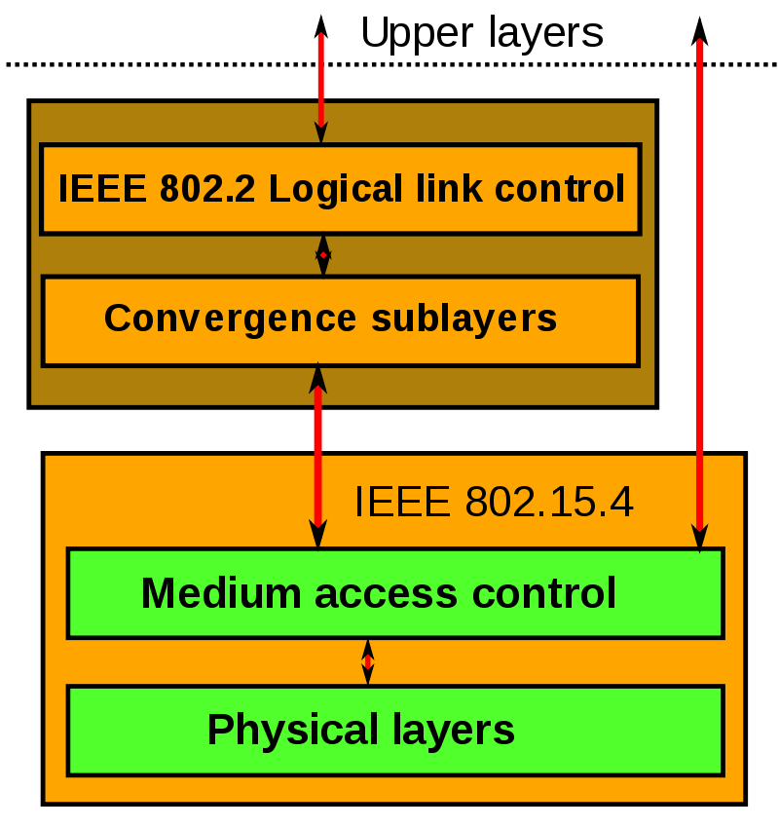
PERSONAL AREA NETWORK
• Used to interconnect portable computers and/or devices like peripherals and sensors
• These devices may be carried or worn by a person and/or may be located nearby Home/Office computers, printers, phones, LANs, GPS or other car resources can be connected as needed. Two or more devices communicate on the same physical channel.
• May include at one FFD that operates as the PAN coordinator.
• The PAN coordinator initiates, terminates, or routes communication around the network. The PAN coordinator is the primary controller of the PAN.
• The WPAN may operate in either of two topologies: the star topology or the peer-to-peer topology.
Devices are conceived to interact with each other over a conceptually simple wireless network. The definition of the network layers is based on the OSI model; although only the lower layers are defined in the standard, interaction with upper layers is intended, possibly using an IEEE 802.2 logical link control sublayer accessing the MAC through a convergence sublayer. Implementations may rely on external devices or be purely embedded, self-functioning devices.

Slide 17
802.15.4 Technology: General Characteristics
Data rates from 20 kb/s (868 MHz) to 250 kb/s (2450 MHz)
ultra-wideband (UWB) and another using chirp spread spectrum (CSS). The UWB PHY is allocated frequencies in three ranges: below 1 GHz, between 3 and 5 GHz, and between 6 and 10 GHz. The CSS PHY is allocated spectrum in the 2450 MHz ISM band
Star or peer-to-peer operation
Allocated 16 bit short or 64 bit extended addresses
Multi-month to multi-year battery life
16 channels in the 2450 MHz band, 10 channels in the 915 MHz band, and 1 channel in the 868 MHz band (European)
Channel Access is via Carrier Sense Multiple Access with collision avoidance and optional time slotting
Message acknowledgement and an optional beacon structure - these are periodic broadcast messages of the access point (for example, every 100 ms). Frames inform clients about the presence of an access point and carry system parameters such as ID, time, interval to the next beacon, and security settings.

Slide 18
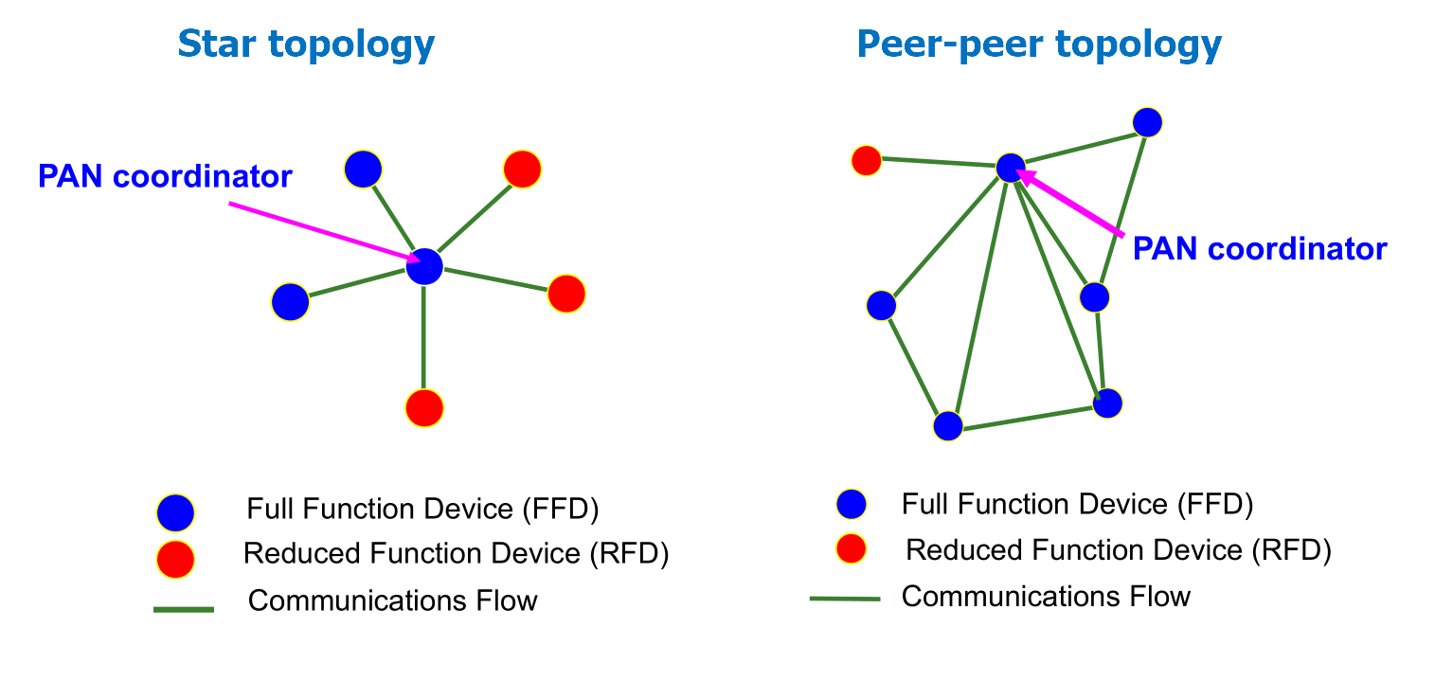
IEEE 802.15.4 Device Types
There are two different device types :
A full function device (FFD)
A reduced function device (RFD)
The FFD can operate in modes serving:
Device
Coordinator (PAN coordinator)
The RFD can only operate in a mode serving:
Device
Full function device (FFD) properties:
Network coordinator capable
Talks to any other device
Reduced function device (RFD) properties:
Cannot become a network coordinator
Talks only to a FFD
Very simple implementation

Slide 19

ZigBee technology
low-power, wirelessly networked, monitoring and control
Products based on an open global standard
45+ companies: Texas Instruments, Motorola, Philips, IBM, Ember, Samsung, NEC, Freescale Semiconductor, LG, OKI, etc.
Defining upper layers of protocol stack: from network to
Application, including application profiles
First profiles published mid 2003
Low power consumption
Low cost
Low offered message throughput
Supports large network orders (<= 65k nodes)
Low to no QoS guarantees
Flexible protocol design suitable for many applications

Slide 20
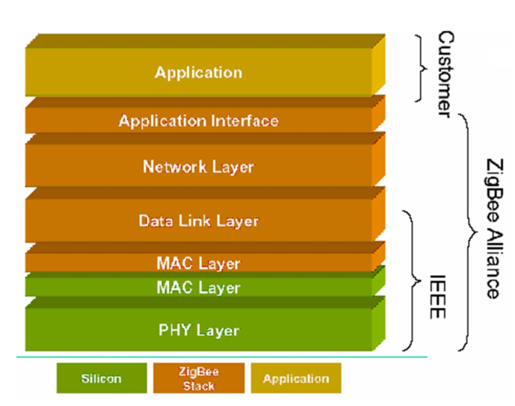
Zigbee protocol stack
Lower (MAC/PHY) stacks IEEE 802.15.4
Upper stacks Zigbee Alliance
IEEE 802 compatible LLC protocol can be used
At the network level, ZigBee defines the routing mechanisms and the formation of the logical network topology.
The ZigBee standard supports a network with a cluster architecture formed from ordinary nodes clustered by routers. cluster routers requesting sensor data from the devices and relaying them to each other, transmit the coordinator, which normally has a connection to an external IP-network, and which sends information storage and final processing.
The ZigBee network is self-organizing, that is, all nodes are able to independently determine and adjust the data delivery routes.

Slide 21
6LoWPAN protocol
Open IP standards open and common standards such as TCP, UDP, HTTP, COAP, MQTT, websockets defined by the IETF are used, standard IP addressing between all nodes is used, no gateway is required as a separate device. The router connects the 6LoWPAN network to traditional IP networks (Internet) Mesh routing one-to-many and many-to-one routing reliable and scalable networks, 50+ nodes self-healing, flexibility in setting, for example, the connection between devices can be optimized by the criteria of minimizing the path length (reducing the number of hops) or the maximum quality of the connection. Supports multiple physical layer standards freedom of choice of frequency range and physical level can be used through several common communication platforms (for example, Ethernet / Wi-Fi / 802.15.4 / Sub-1GHz ISM), IP interaction.

Slide 22
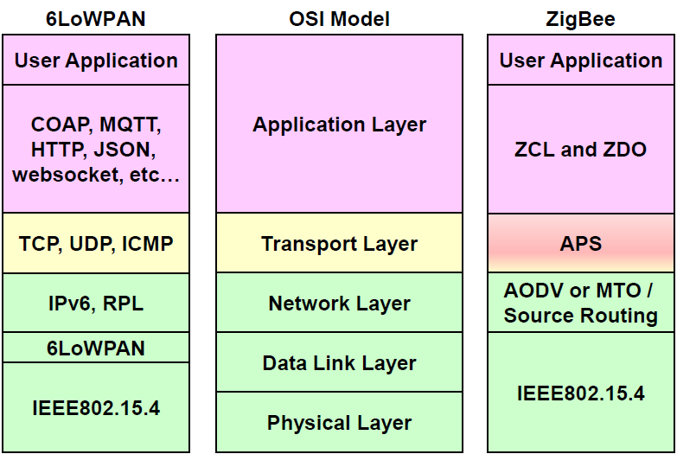
main differences of networks
6LoWPAN is between 2 and 3 levels. While ZigBee is located from 3 to 6.
http://www.ti.com/lit/wp/swry013/swry013.pdf

Slide 23
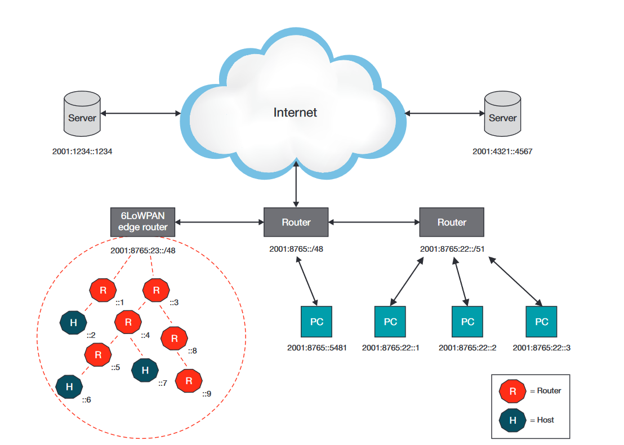
An example of an IPv6 network with a 6LoWPAN mesh network
Main scopes of the standard 6LoWPAN: intellectual accounting systems; street lighting control; industrial automation; logistics systems, tracking goods or inventory items; commercial security systems, access control systems; some military applications.

Slide 24
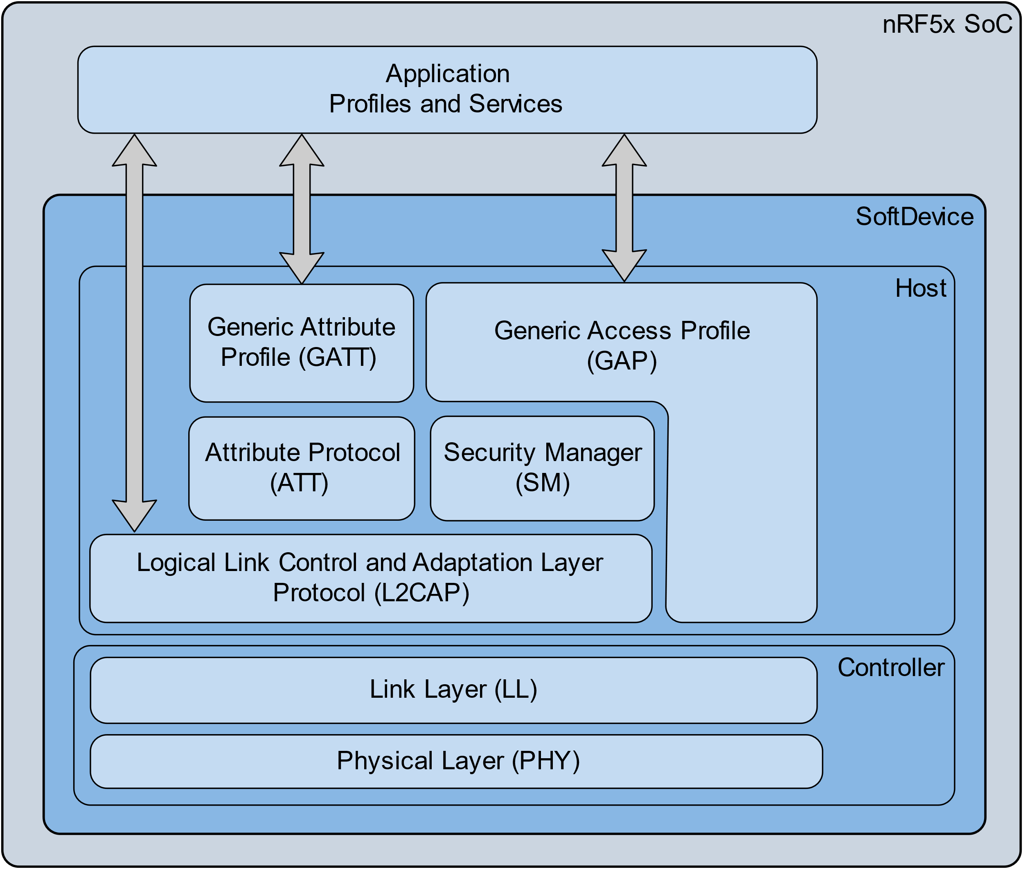
Bluetooth Low Energy
Like the classic Bluetooth protocol stack, the BLE stack consists of two main parts: the controller (controller) and the network node (host). The controller includes a physical and data link layer and is often implemented as a system-on-a-chip with an integrated wireless transceiver. The part of the stack, referred to as the network node, is implemented programmatically on the application microcontroller and includes the functionality of the upper levels: L2CAP (Logical Link Control and Adaptation Protocol), GATT Attribute Protocol (ATT) (Generic Attribute Profile), Security Management Protocol (SMP), Security Access Protocol (GAP) (Generic Access Profile). The interaction between the upper and lower parts of the stack is carried out through the interface HCI (Host Controller Interface).

Slide 25
Technical details
Data transfers BLE supports very short data packets (8 octet minimum up to 27 octets maximum) that are transferred at 1 Mbps. All connections use advanced sniff-sub rating to achieve ultra-low duty cycles to keep energy consumption to a minimum.
Frequency hopping BLE uses the AFH common to all versions of Bluetooth technology to minimize interference from other technologies in the 2.4 GHz ISM Band. Efficient multi-path benefits increase link budgets and effective operating range as well as optimize energy consumption.
Host control BLE places a significant amount of intelligence in the controller. This allows the host to sleep for longer periods of time and be woken up by the controller only when the host needs to perform some action. This allows for the greatest current savings since the host processor typically consumes greater power than the BLE controller.
Latency BLE can support connection setup and data transfer in as quickly as 3 ms. This enables an application to establish a connection and transfer authenticated data in just a few milliseconds for a short communication burst before quickly tearing down the connection.
Range An increased modulation index allows for a maximum range for BLE of over 100 meters.
Robustness BLE uses a strong 24-bit CRC on all packets to ensure the maximum robustness against interference.
Strong security Full AES-128 encryption using CCM provides strong encryption and authentication of data packets so communications are secure.
Topology BLE uses a 32-bit access address on every packet for each slave, allowing billions of devices to be connected. The technology is optimized for one-to-one connections while allowing one-to-many connections using a star topology.
https://www.radiolocman.com/review/article.html?di=183939

Slide 26
Ble Technical details
Technical specification | Bluetooth Basic Rate/Enhanced Data Rate technology | Bluetooth Low Energy technology
Distance/range (theoretical max.) | 100 m (330 ft) | >100 m (>330 ft)
Over the air data rate | 1–3 Mbit/s | 125 kbit/s – 1 Mbit/s – 2 Mbit/s
Application throughput | 0.7–2.1 Mbit/s | 0.27-1.37 Mbit/s ^{[35]}
Active slaves | 7 | Not defined; implementation dependent
Security | 56/128-bit and application layer user defined | 128-bit AES in CCM mode and application layer user defined
Robustness | Adaptive fast frequency hopping, FEC, fast ACK | Adaptive frequency hopping, Lazy Acknowledgement, 24-bit CRC, 32-bit Message Integrity Check
Latency (from a non-connected state) | Typically 100 ms | 6 ms
Minimum total time to send data (det. battery life) | 0.625 ms | 3 ms ^{[36]}
Voice capable | Yes | No
Network topology | Scatternet | Scatternet
Power consumption | 1 W as the reference | 0.01–0.50 W (depending on use case)
Peak current consumption | <30 mA | <15 mA
Service discovery | Yes | Yes
Profile concept | Yes | Yes
Primary use cases | Mobile phones, gaming, headsets, stereo audio streaming, smart homes, wearables, automotive, PCs, security, proximity, healthcare, sports & fitness, etc. | Mobile phones, gaming, smart homes, wearables, automotive, PCs, security, proximity, healthcare, sports & fitness, Industrial, etc.

Slide 27
Comparing characteristics of the Wireless Area Networks
 | ZigBee (IEEE 802.15.4) | WiFi (IEEE 802.11b) | Bluetooth (IEEE 802.15.1)
Frequency range | 2.4-2.483 GHz | 2.4-2.483 GHz | 2.4-2.483 GHz
Bandwidth, kbps | 250 | 11000 | 7131.1
The size of the protocol stack, KB | 32-36 | >1000 | >250
Continuous battery life, days | 100 – 1000 | 0.5 – 5 | 1 – 10
Maximum number of nodes in the network | 65536 | 10 | 7
Range of action, m | 10 – 100 | 20 – 300 | 10 – 100
Application areas | Remote monitoring and control | The transfer of multimedia information | Wire Substitution

Slide 28
Application Layer Protocols for IOT
• MQTT
• SMQTT
• CoAP
• DDS
• XMPP
• AMQP
• RESTful HTTP
• MQTT-SN
• STOMP
• SMCP
• LLAP
• SSI
• LWM2M
• M3DA
• XMPP-IOT
• ONS 2.0
• SOAP
• Websocket
• Reactive Streams
• HTTP/2
• JavaScript IOT
https://www.engineersgarage.com/Articles/IoT-Application-Layer-Protocols

Slide 29
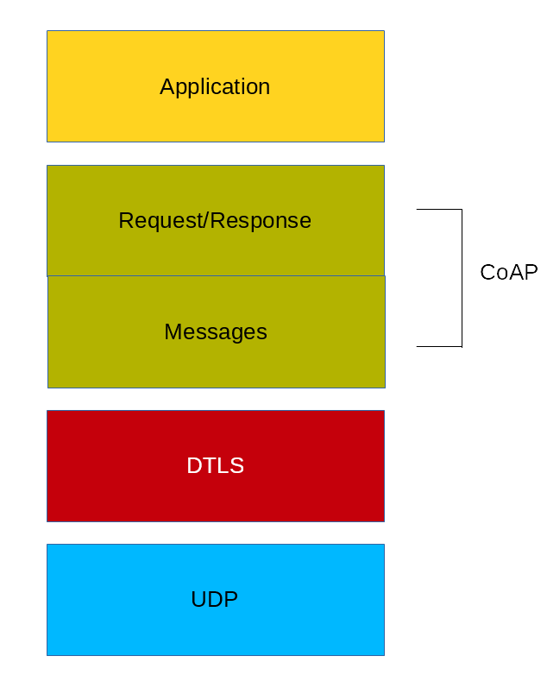
CoAP Protocol
The main features of CoAP protocols are:
Web protocol used in M2M with constrained requirements
Asynchronous message exchange
Low overhead and very simple to parse
URI and content-type support
Proxy and caching capabilities
GET, POST, PUT, DELETE
CoAP supports four different message types:
Confirmable
Non-confirmable
Acknowledgment
Reset
https://dzone.com/articles/coap-protocol-step-by-step-guide
http://coap.technology/spec.html
https://tools.ietf.org/html/rfc8323

Slide 30
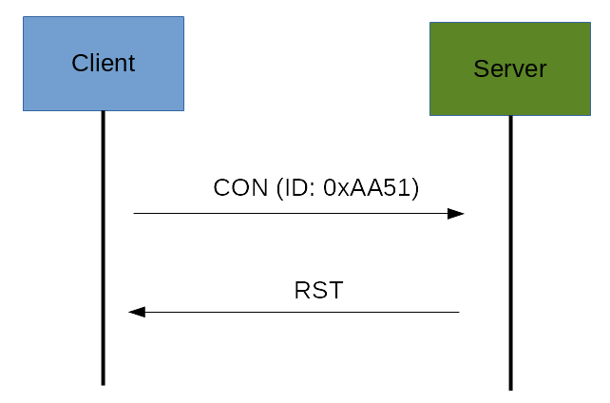
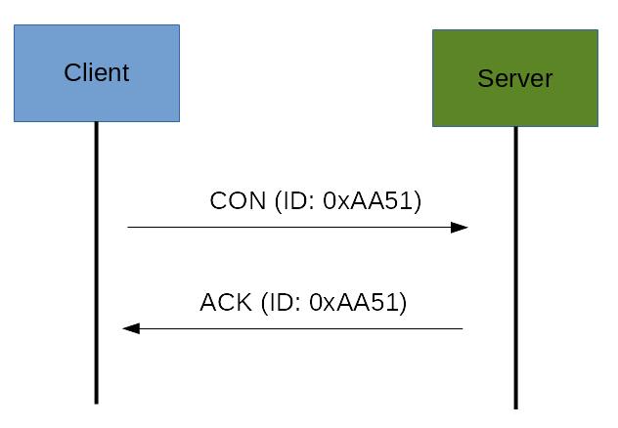
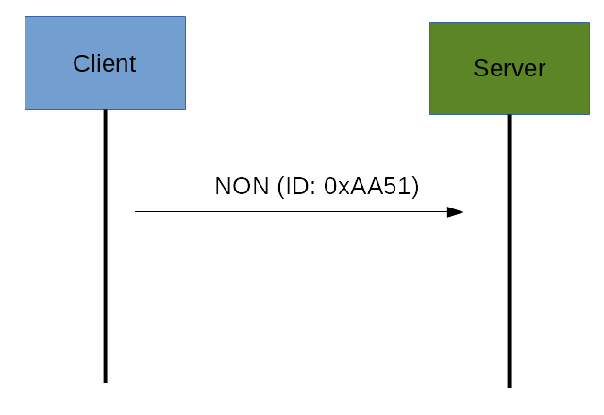
CoAP Messages Model
A confirmable message is a reliable message. When exchanging messages between two endpoints, these messages can be reliable. In CoAP, a reliable message is obtained using a Confirmable message (CON). Using this kind of message, the client can be sure that the message will arrive at the server. A Confirmable message is sent again and again until the other party sends an acknowledge message (ACK). The ACK message contains the same ID of the confirmable message (CON).
If the server has troubles managing the incoming request, it can send back a Rest message (RST) instead of the Acknowledge message (ACK)
The other message category is the Non-confirmable (NON) messages. These are messages that don’t require an Acknowledge by the server. They are unreliable messages or in other words messages that do not contain critical information that must be delivered to the server. To this category belongs messages that contain values read from sensors.

Slide 31
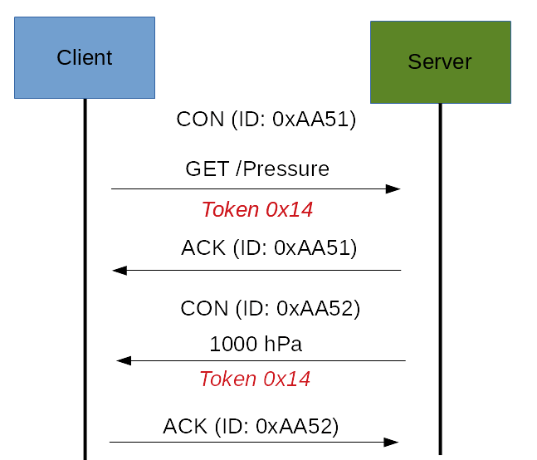
CoAp Request/Response Model
The CoAP Request/Response is the second layer in the CoAP abstraction layer. The request is sent using a Confirmable (CON) or Non-Confirmable (NON) message. There are several scenarios depending on if the server can answer immediately to the client request or the answer if not available.If the server can answer immediately to the client request, then if the request is carried using a Confirmable message (CON), the server sends back to the client an Acknowledge message containing the response or the error code
As you can notice in the CoAP message, there is a Token. The Token is different from the Message-ID and it is used to match the request and the response. If the server can’t answer to the request coming from the client immediately, then it sends an Acknowledge message with an empty response. As soon as the response is available, then the server sends a new Confirmable message to the client containing the response. At this point, the client sends back an Acknowledge message

Slide 32
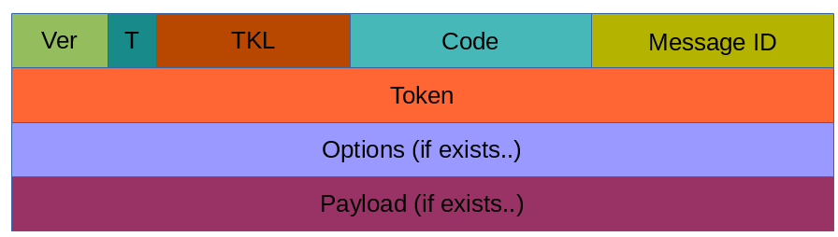
CoAp Message Format
To avoid fragmentation, a message occupies the data section of a UDP datagram. A message is made by several parts:
Ver: It is a 2 bit unsigned integer indicating the version
T: it is a 2 bit unsigned integer indicating the message type: 0 confirmable, 1 non-confirmable
TKL: Token Length is the token 4 bit length
Code: It is the code response (8 bit length)
Message ID: It is the message ID expressed with 16 bit

Slide 33
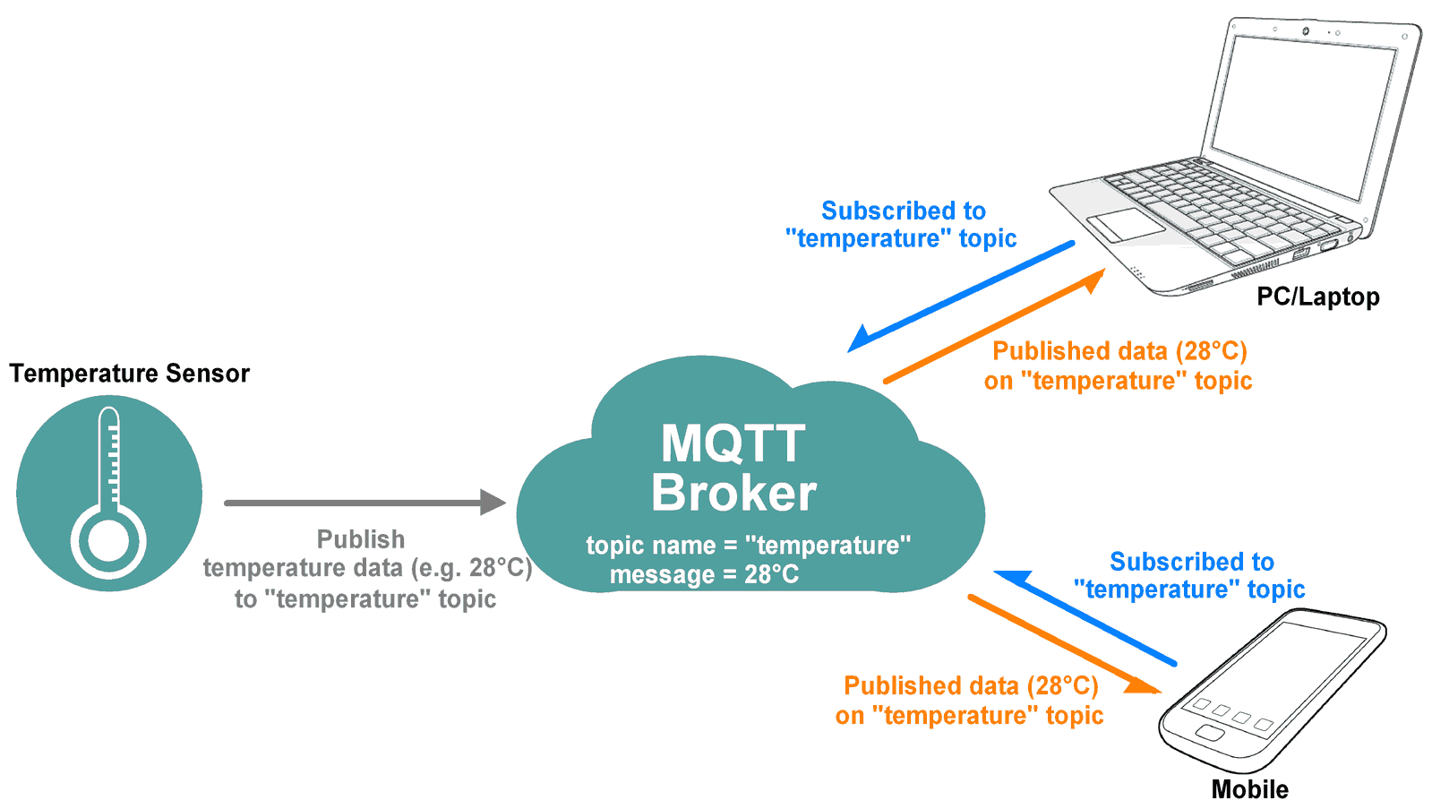
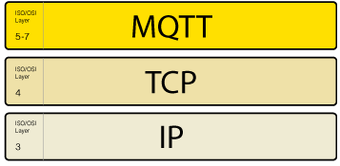
Mqtt protocol
Asynchronous protocol
Compact messages
Work in conditions of unstable communication
Support for multiple levels of quality of service (QoS)
Easy integration of new devices
The MQTT protocol works at the application layer of TCP / IP surfaces and uses port 1883 by default (8883 when connected via SSL).
http://docs.oasis-open.org/mqtt/mqtt/v3.1.1/os/mqtt-v3.1.1-os.html#_Toc398718098
https://1sheeld.com/mqtt-protocol/

Slide 34
How MQTT works
Like any other internet protocol, MQTT is based on clients and a server. Likewise, the server is the guy who is responsible for handling the client’s requests of receiving or sending data between each other.
MQTT server is called a broker and the clients are simply the connected devices. So:
When a device (a client) wants to send data to the broker, we call this operation a “publish”.
When a device (a client) wants to receive data from the broker, we call this operation a “subscribe”.
In addition, These clients are publishing and subscribing to topics. So, the broker here is the one that handles the publishing/subscribing actions to the target topics.
The number of connected devices “clients” to the broker depends on the broker service provider.

Slide 35
Comparison of HTTP and MQTT protocol characteristics
Operation | HTTP | MQTT | Economy
Reading one block of data from the server | 302 bytes | 69 bytes | 4 times less
Write one data block to server | 320 bytes | 47 bytes | 7 times less
Reading 100 data blocks from the server | 12600 bytes | 2445 bytes | 5 times less
Writing 100 data blocks to the server | 14100 bytes | 2126 bytes | 7 times less

Slide 36
difference between CoAP, MQTT, HTTP protocols
Criteria | HTTP | CoAP | MQTT
Architecture | Client/Server | Client/Server or Client/Broker | Client/Broker
Abstraction | Request/Response | Request/Response or Publish/Subscribe | Publish/Subscribe
Header Size | Undefined | 4 Byte | 2 Byte
Message size | Large and Undefined (depends on the web server or the programming technology) | Small and Undefined (normally small to fit in single IP datagram) | Small and Undefined (up to 256 MB maximum size)
Semantics/Methods | Get, Post, Head, Put, Patch, Options, Connect, Delete | Get, Post, Put, Delete | Connect, Disconnect, Publish, Subscribe, Unsubscribe, Close
Quality of Service (QoS) /Reliability | Limited (via Transport Protocol - TCP) | Confirmable Message or Non-confirmable Message | QoS 0 - At most once QoS 1 - At least once QoS 2 - Exactly once
Transport Protocol | TCP | UDP, TCP | TCP (MQTT-SN can use UDP)
Security | TLS/SSL | DTLS/IPSEC | TLS/SSL
Default Port | 80/443 (TLS/SSL) | 5683 (UDP)/5684 (DTLS) | 1883/8883 (TLS/SSL)

